Slide 1
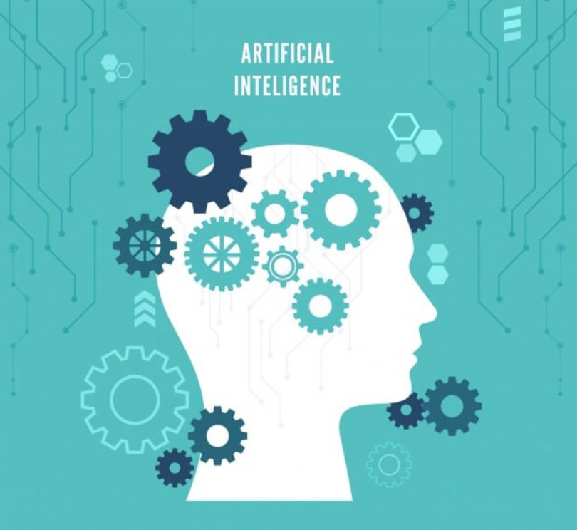
An Introduction to Text Mining

Slide 2
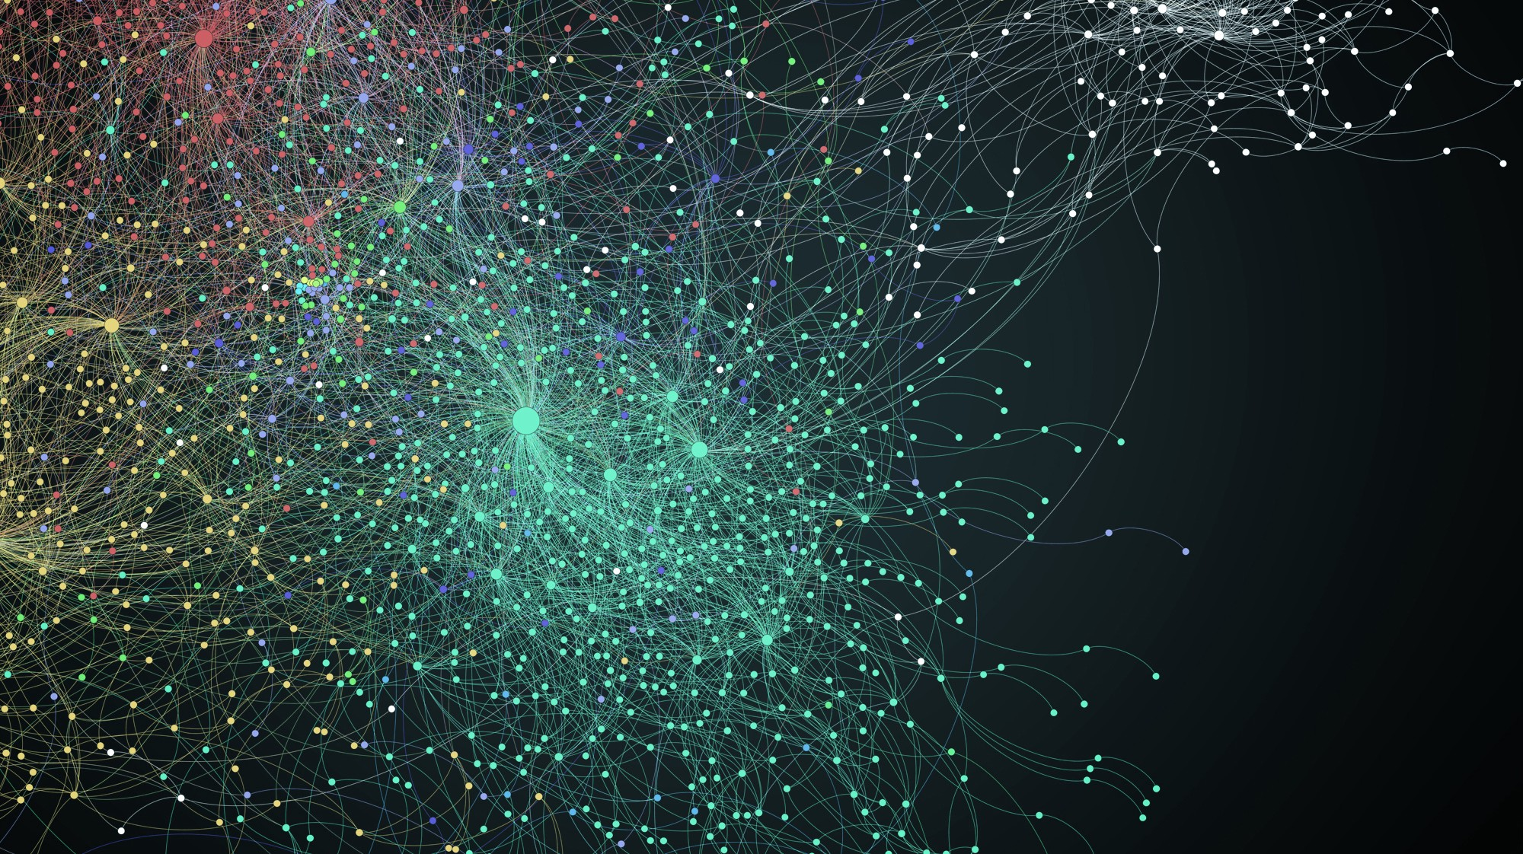

Chat bot

Slide 3
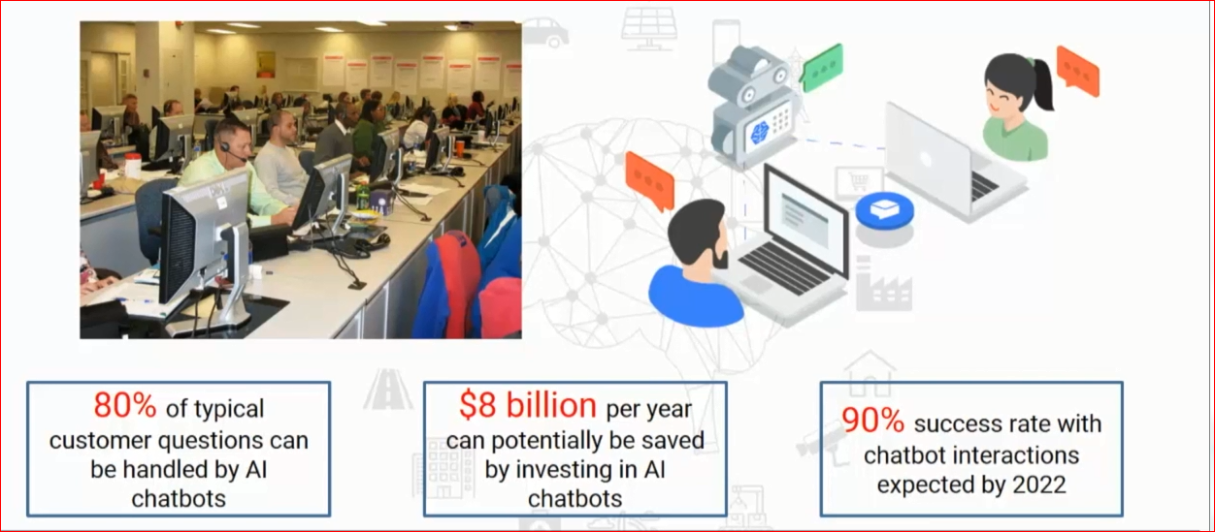
Chatbots in Future

Slide 4
Working with Text
Dr Venugopala Rao Manneni
www.statsvenu.com

Slide 5
Content
Why Natural Language Processing
What is Natural Language Processing
Tasks Of Natural Language Processing
Machine / Deep Learning and NLP
How To Learn Natural Language Processing
Hands on

Slide 6
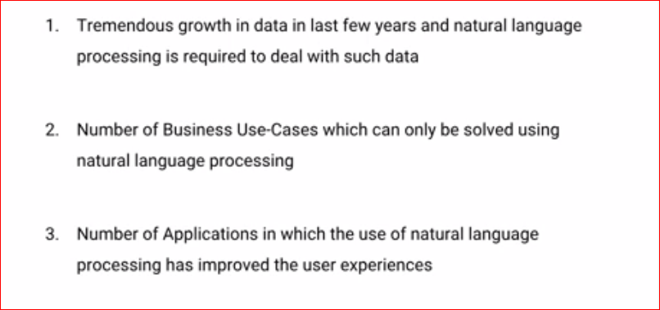
Why NLP

Slide 7
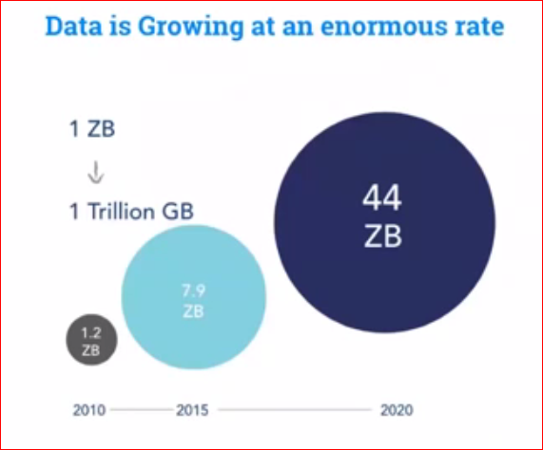
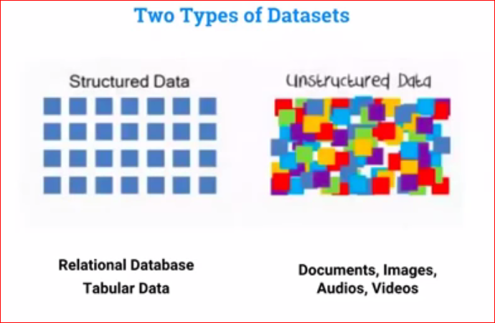
Data Growth

Slide 8
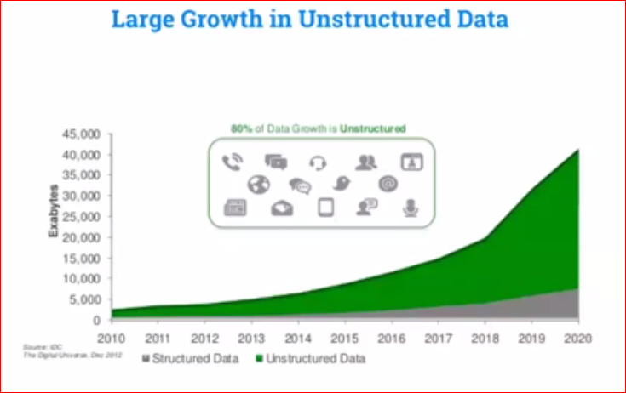
Out of 100 percept 80% growth is unstructured data

Slide 9
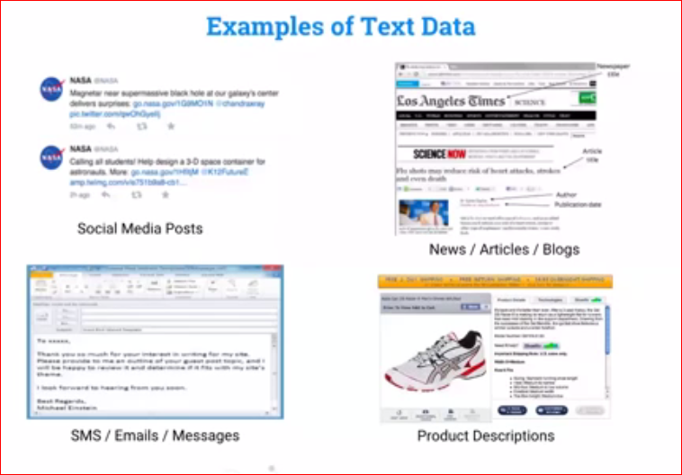
Text Data

Slide 10
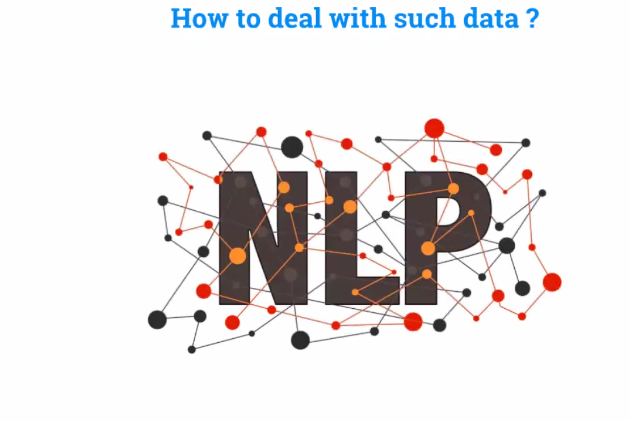
The Solution is

Slide 11
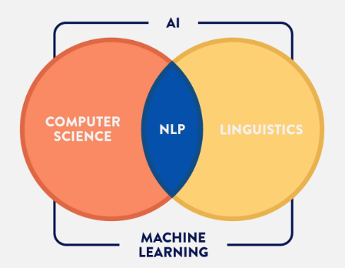
NATURAL LANGUAGE PROCESSING
NLP is an intersection of computer science , linguistics(scientific study of language), and machine learning that is connected with communication between computers and humans in natural language

Slide 12
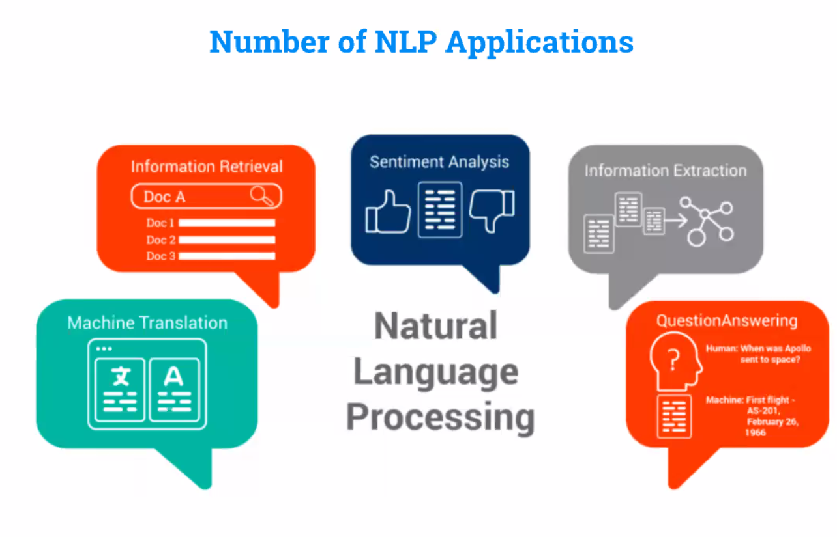

Slide 13

APPLICATIONS OF NLP:

Slide 14
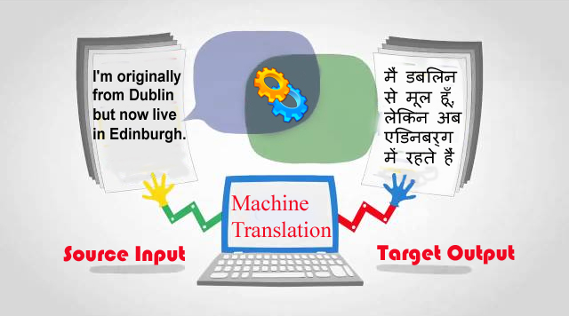
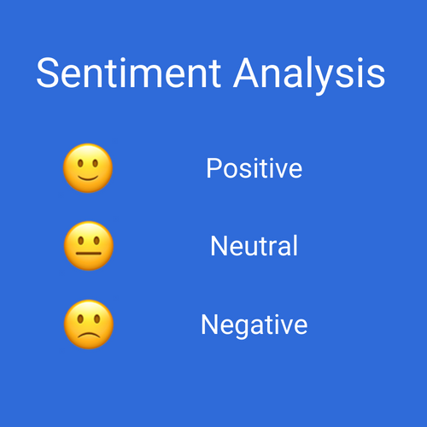
Machine Translation: it is process by which computer software is used to translate a text from one natural language to another.
Sentiment Analysis: sentiment analysis is also known as opnion mining is a field within NLP that builds systems that try to identify and extract opnion within text.

Slide 15

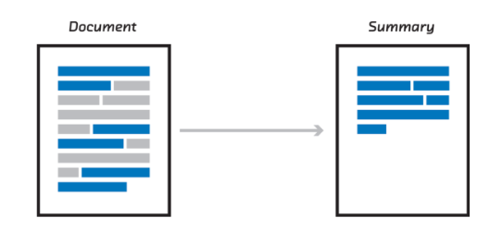
Image Captioning: this is the process of generating textual description of an image .it uses both NLP and computer vision to generate the captions.
Automatic Summarization: it is the process of shortening a text document with software,in order to create a summary with the major points of the original documents.

Slide 16
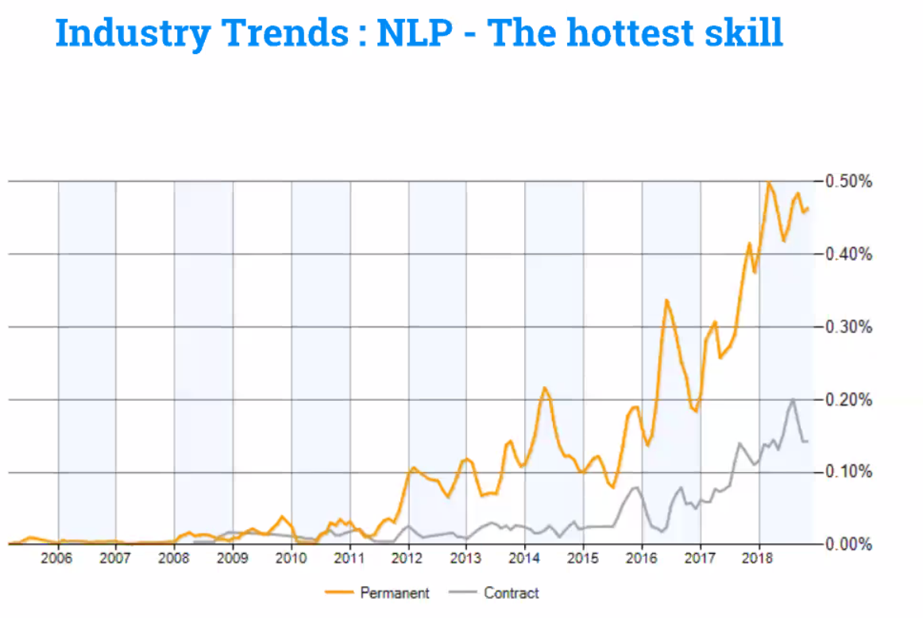

Slide 17
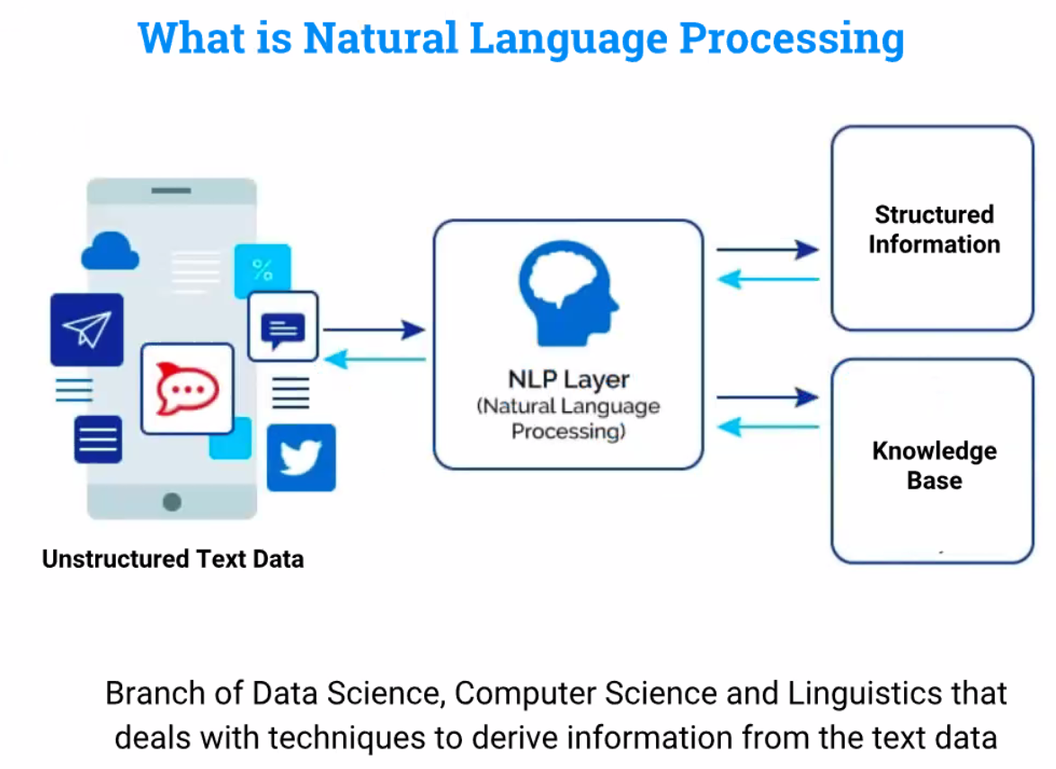

Slide 18
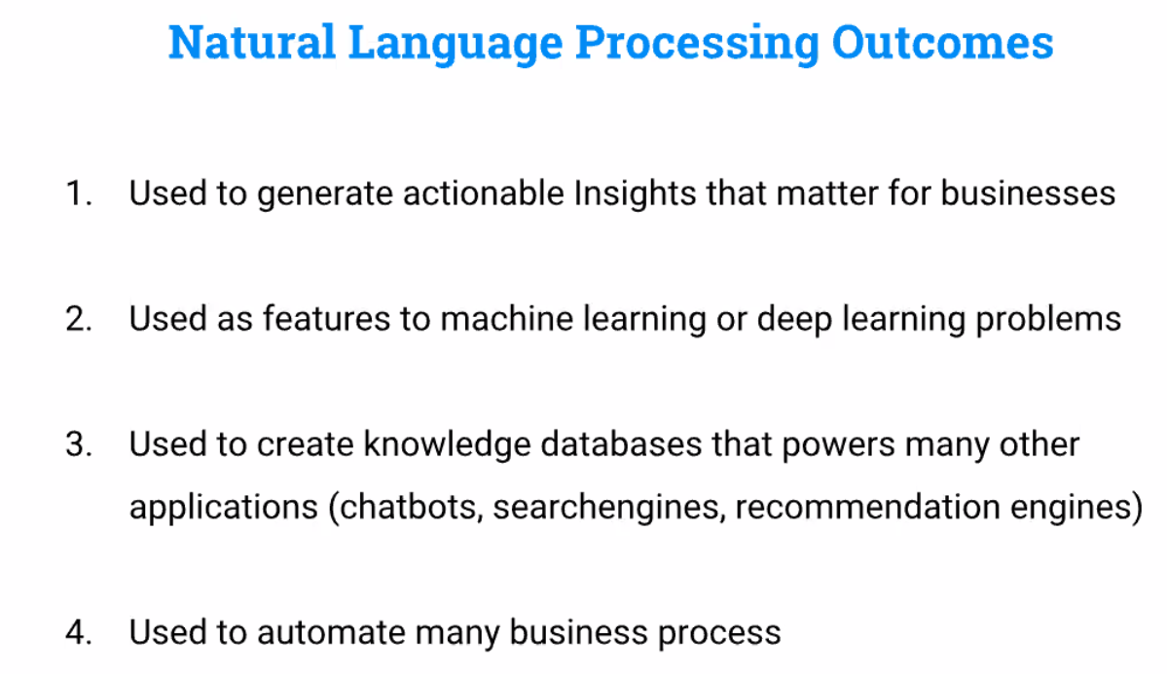
Structured Information can be used as below:

Slide 19
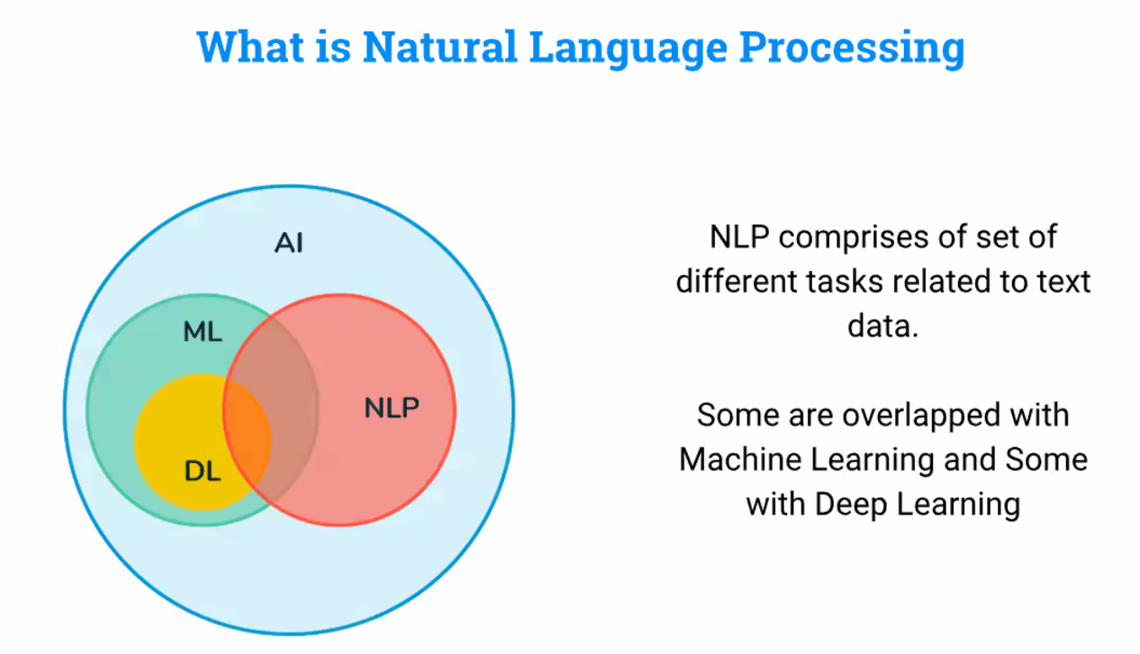

Slide 20
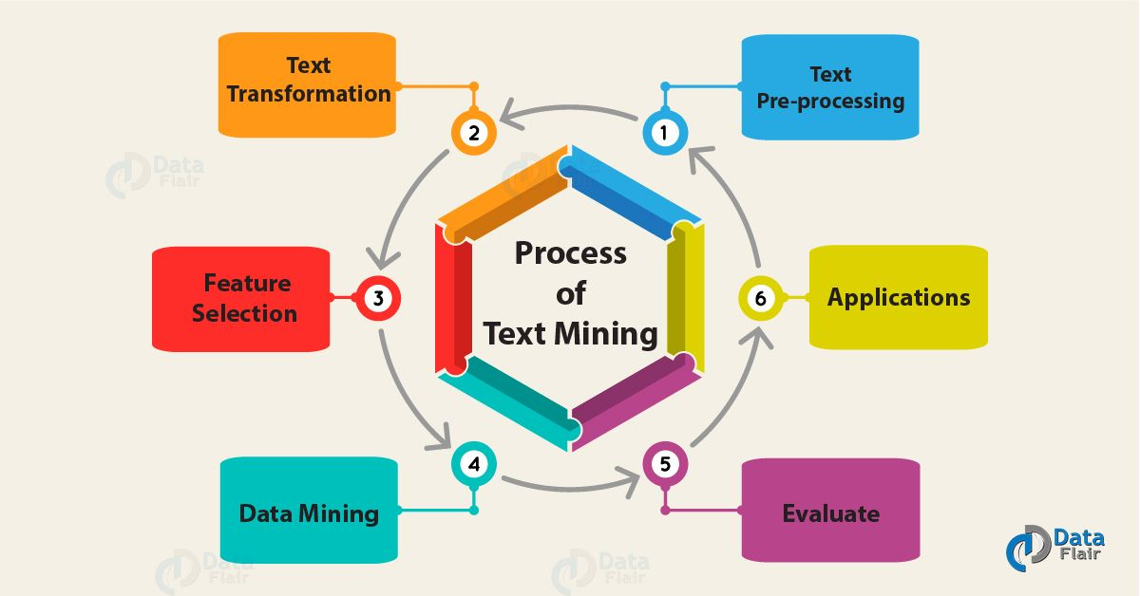
STANDARD NLP WORKFLOW

Slide 21

TEXT PRE-PROCESSING

Slide 22
What is text preprocessing?
To preprocess your text simply means to bring your text into a form that is predictable and analyzable for your task
Types of text pre-processing techniques
There are different ways to preprocess your text. Here are some of the approaches that you should know about
Lowercasing:
Lowercasing ALL your text data
Noise Removal:
This includes punctuation removal, spell checking, special character removal
Removing HTML tags:
Expanding Contractions:
Contractions are shortened version of words or syllables.
Ex: do not to don’t and I would to I’d
Removing accented characters :
Converting into ASCII
Ex: converting é to e.
Removing Special Characters:
Special characters and symbols are usually non-alphanumeric

Slide 23
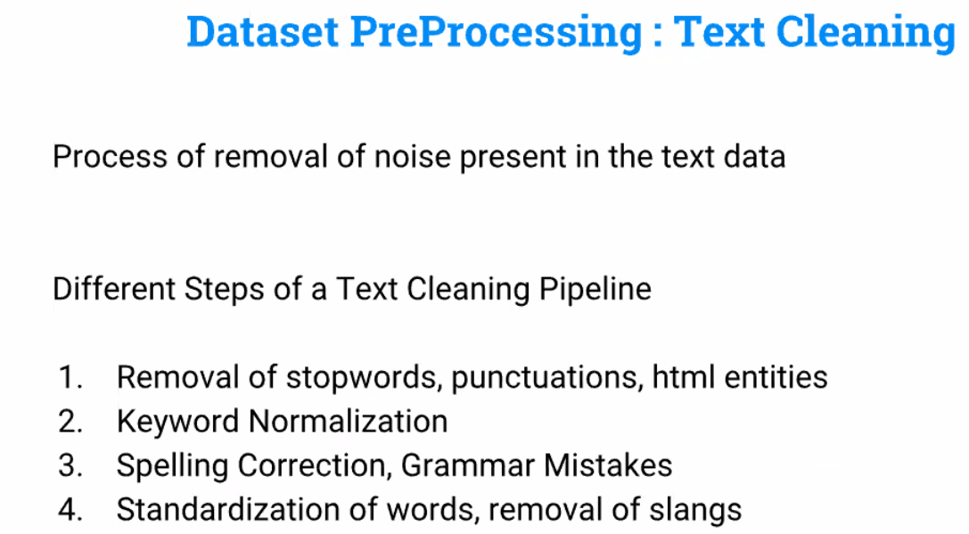

Slide 24
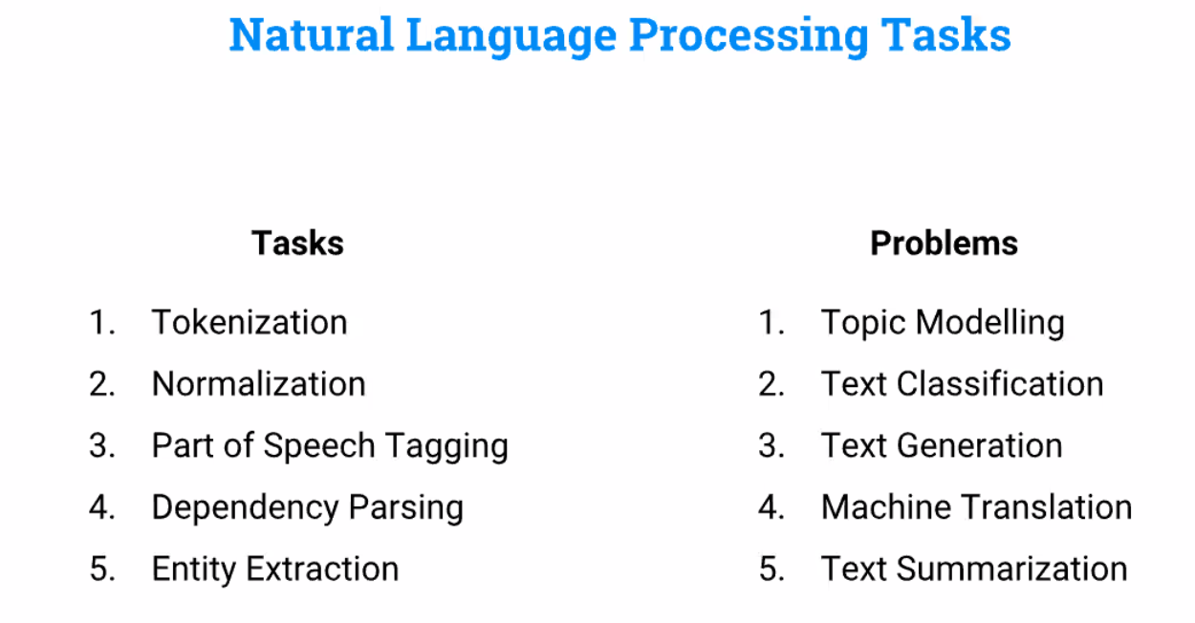

Slide 25
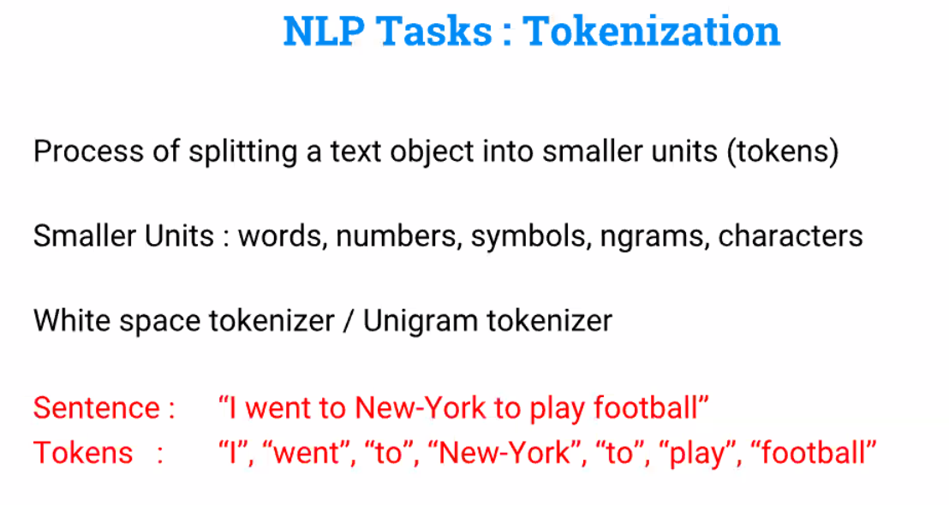
Text Pre Processing - Tokenization

Slide 26
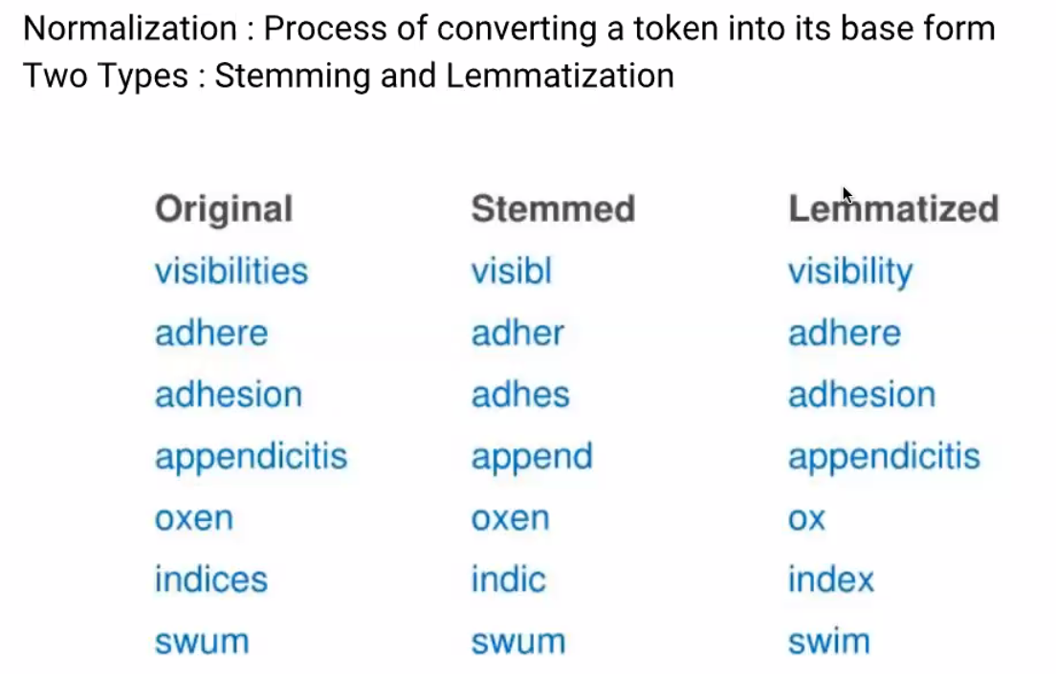
Normalization

Slide 27
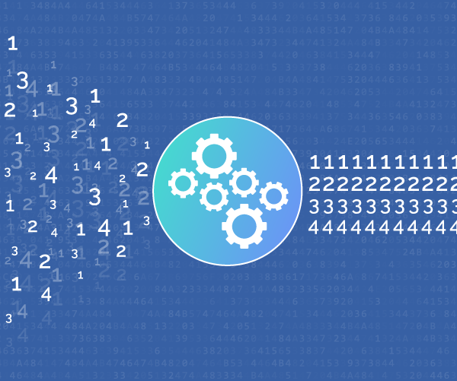
FEATURE ENGINEERING

Slide 28
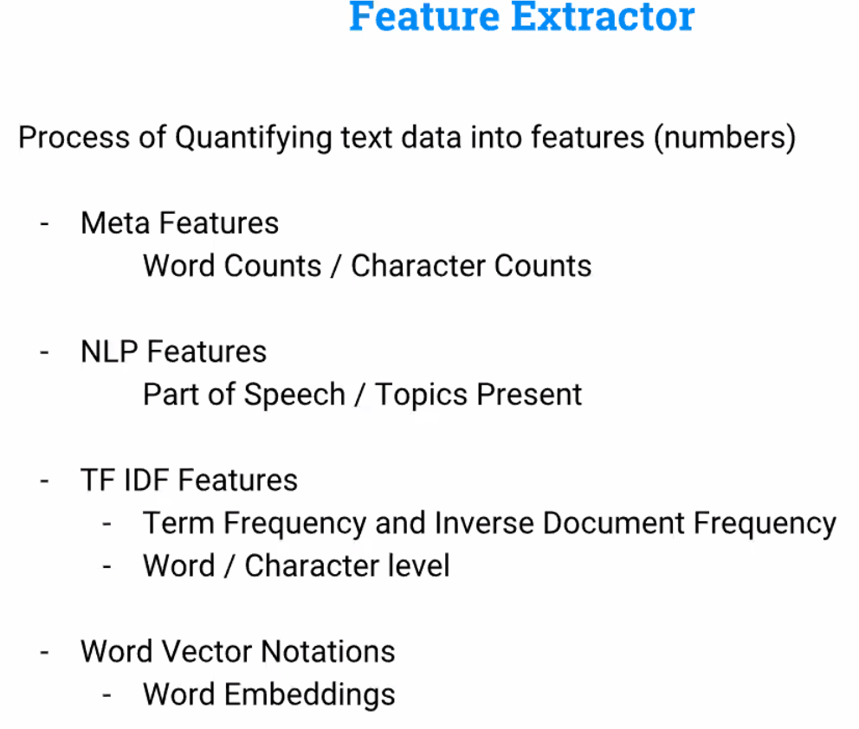

Slide 29
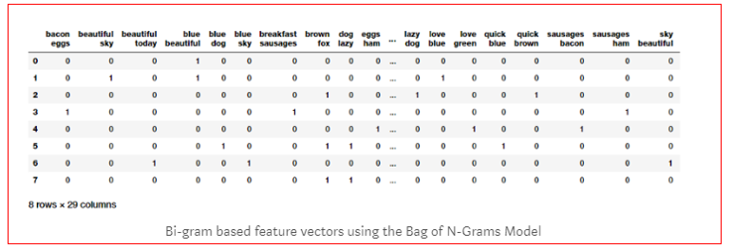
Bag of N-Grams Model
The Bag of Words model doesn’t consider order of words. But what if we also wanted to take into account phrases or collection of words which occur in a sequence?
N-grams help us achieve that
An N-gram is basically a collection of word tokens from a text document such that these tokens are contiguous and occur in a sequence.
Bi-grams indicate n-grams of order 2 (two words), Tri-grams indicate n-grams of order 3 (three words), and so on.

Slide 30
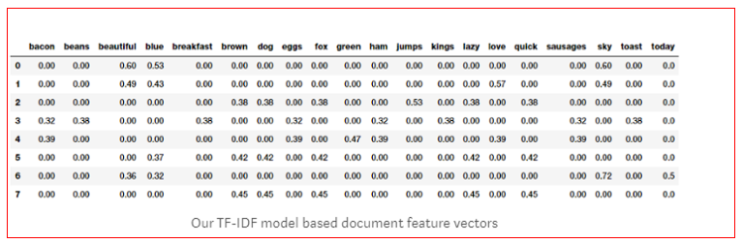
TF-IDF Model
TF-IDF stands for Term Frequency-Inverse Document Frequency.
Term Frequency: This summarizes how often a given word appears within a document.

Inverse Document Frequency: This downscales words that appear a lot across documents.
The TF-IDF based feature vectors for each of our text documents show scaled and normalized
values as compared to the raw Bag of Words model values.

Slide 31
Word Embedding
Word embedding is one of the most popular representations of document vocabulary.It is capable of capturing context of a word in a document, semantic and syntactic similarity,relation with other words, etc
Word embeddings are a type of word representation that allows words with similar meaning to have a similar representation.
Example for Word Embedding
Word2Vec :is one of the most popular technique to learn word embeddings
This model was created by Google in 2013 and is a predictive deep learning based model
GloVe Model : The GloVe model stands for Global Vectors which is an unsupervised learning model which can be used to obtain dense word vectors similar to Word2Vec
The Fast Text Model :The model was first introduced by Facebook in 2016 as an extension and supposedly improvement of the vanilla Word2Vec mode

Slide 32
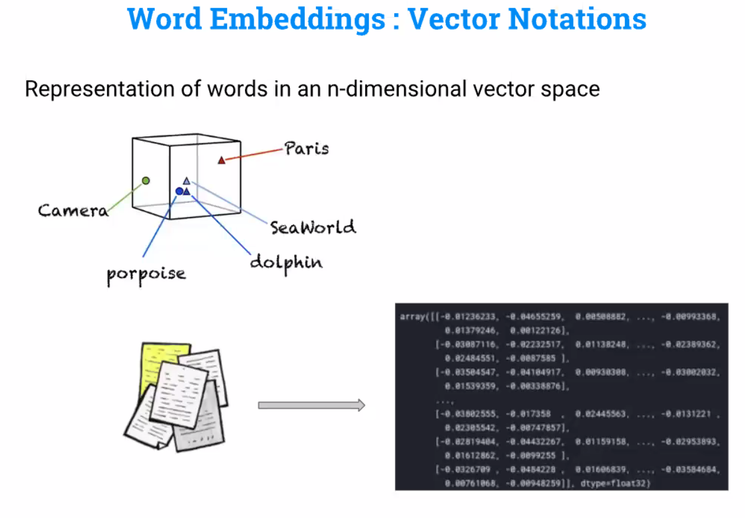

Slide 33
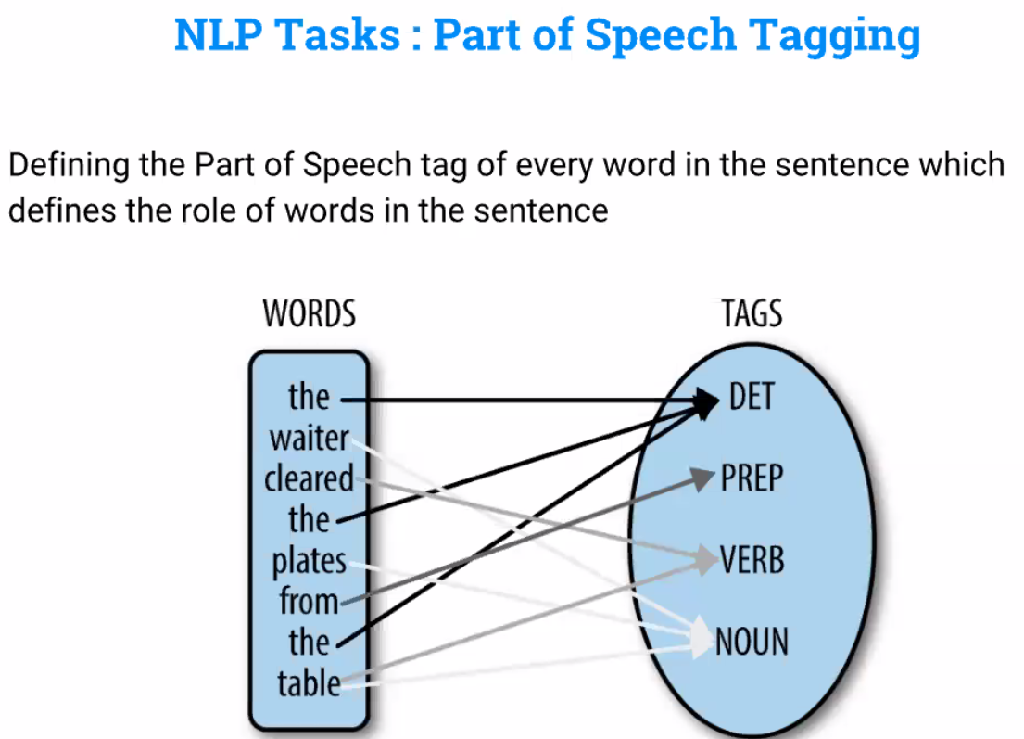
Role / Function of given word

Slide 34
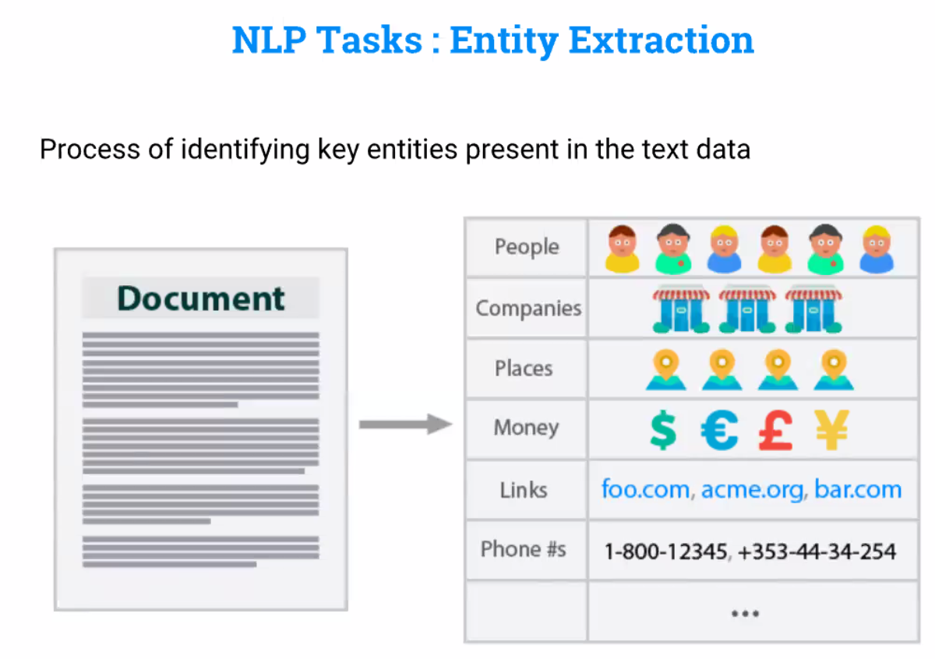

Slide 35
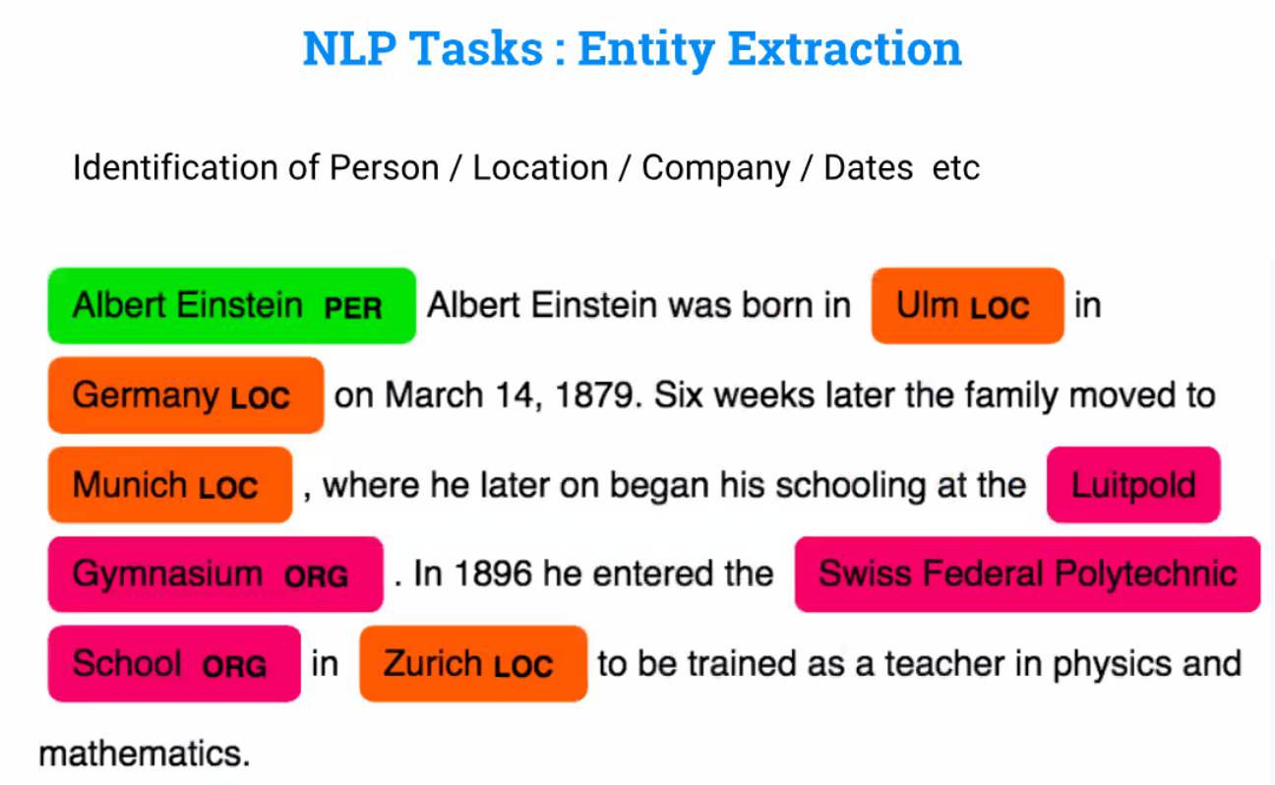

Slide 36
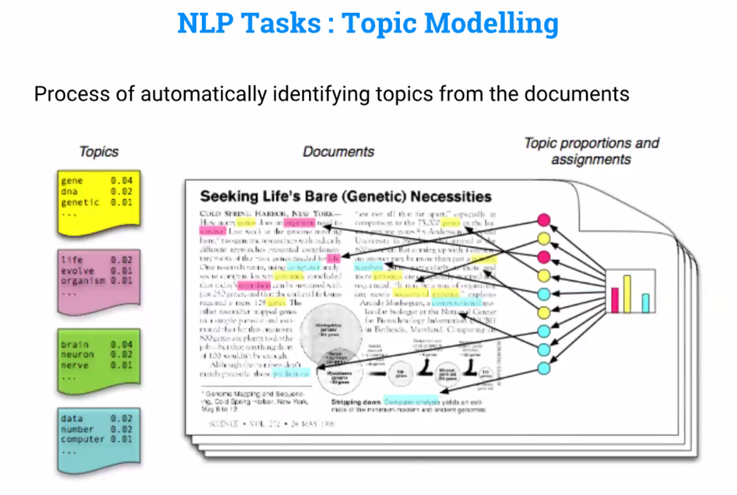

Slide 37
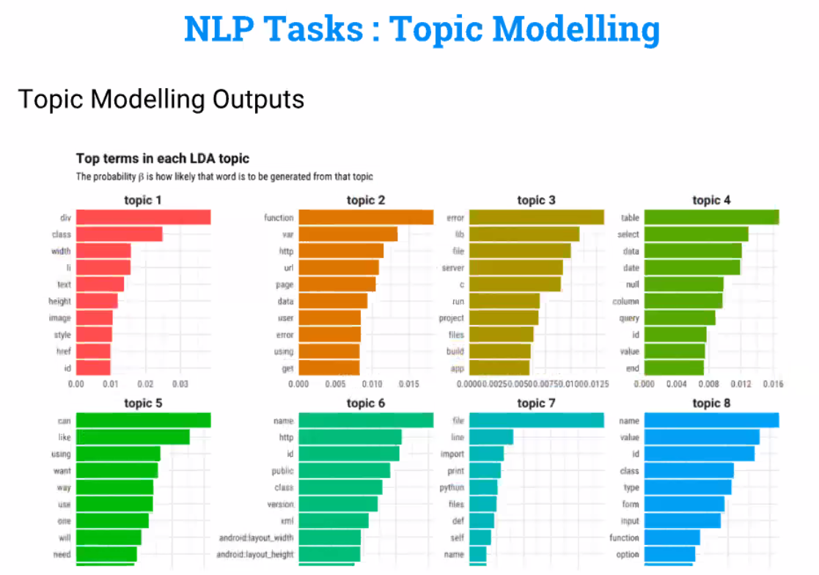

Slide 38

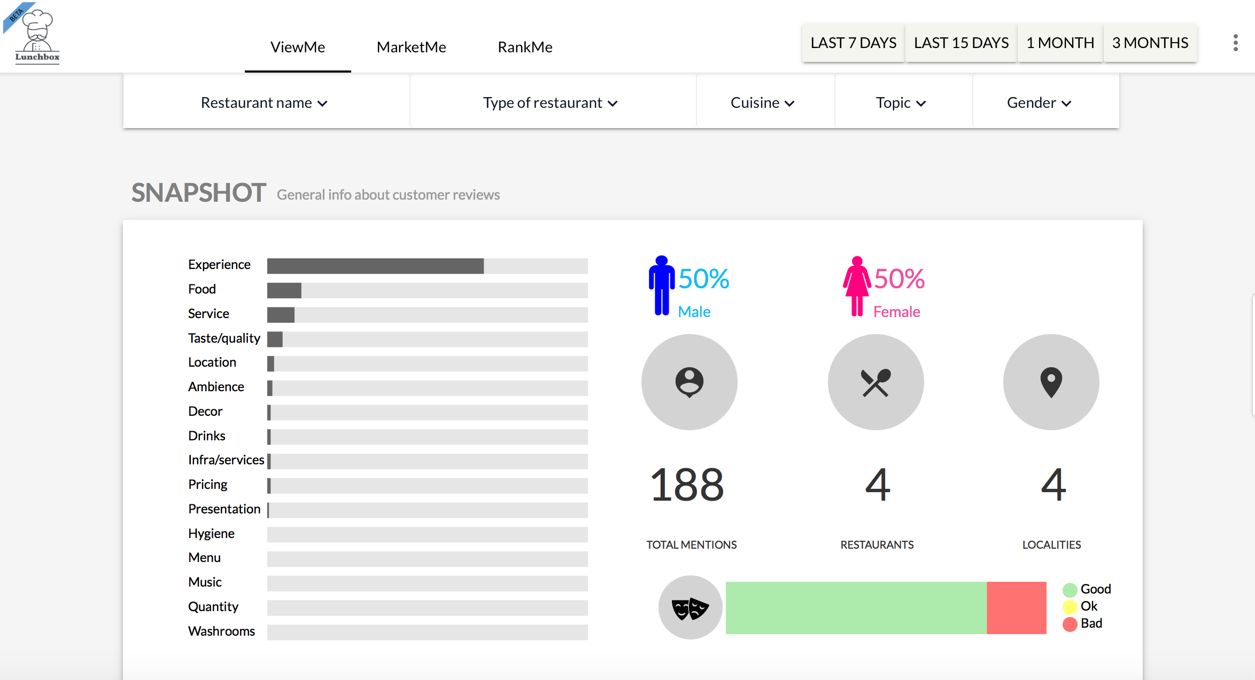
MINING CUSTOMER REVIEWS
We focused on the following questions for analysing the reviews:
What are the keywords and topics of discussion across the comments?
What elements of the restaurant would they want improved – service, staff behaviour, ambience etc.?
What is the overall mood of the customers visiting the restaurant?
Using advanced techniques of text analytics - machine learning for topics classification, sentiment analysis, and more, we developed a module where restaurant collected reviews could also be analysed and compared for taking better decisions.
Challenge
Offering critical insights into brand perception and competitive scenarios to experience brands wanting to manage and learn from data on review sites that is viewed by millions.
Solution
We scrapped over 10 million customer reviews for more than 100000 restaurants across India.

Slide 39
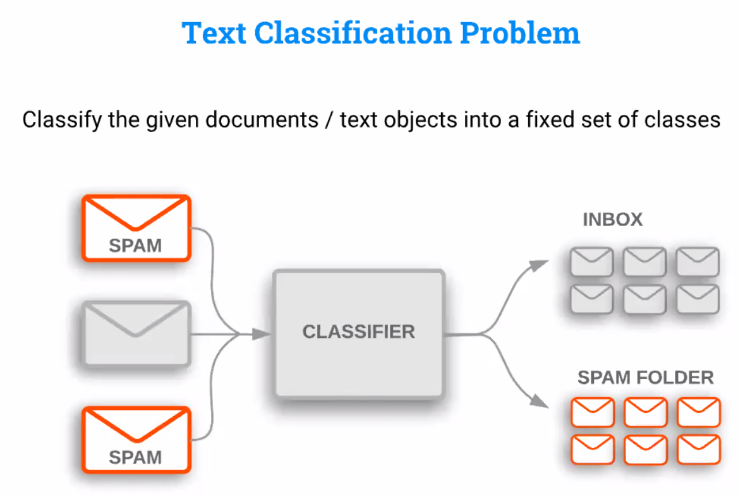
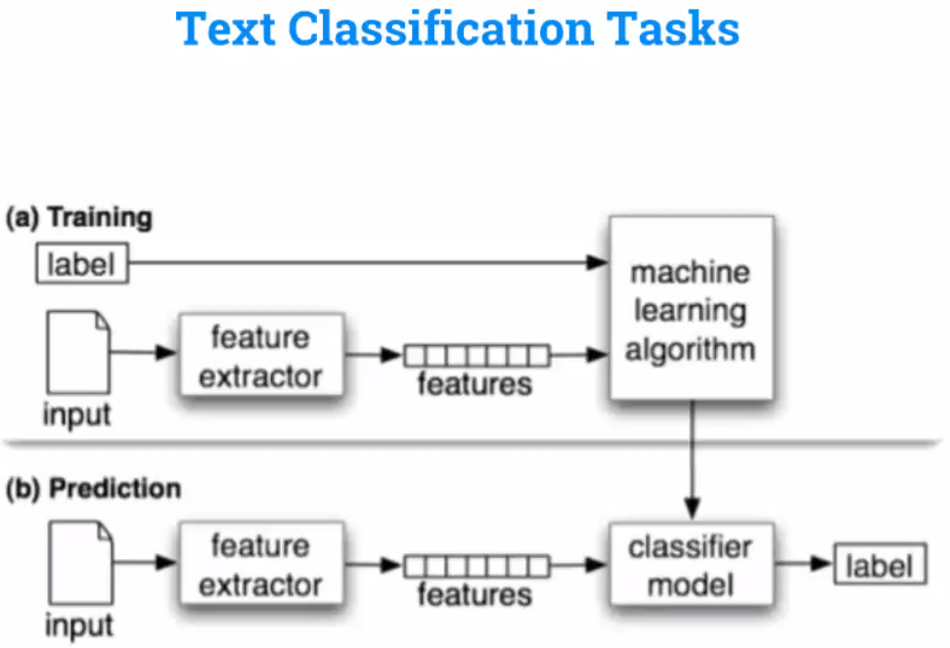
Machine Learning and NLP

Slide 40
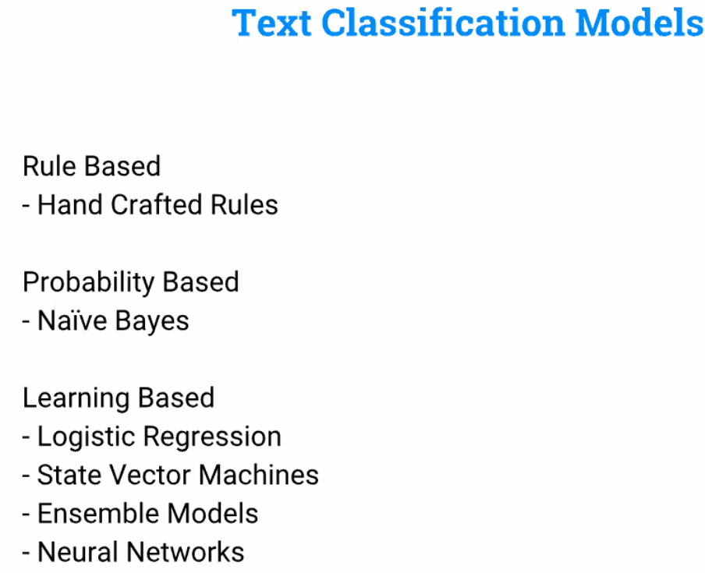

Slide 41
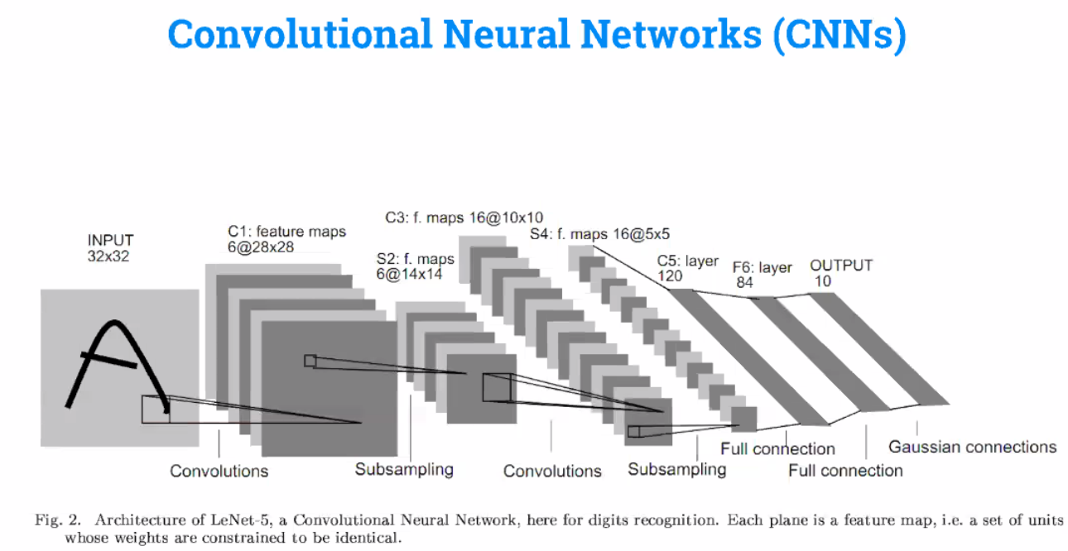
Deep Learning and NLP

Slide 42
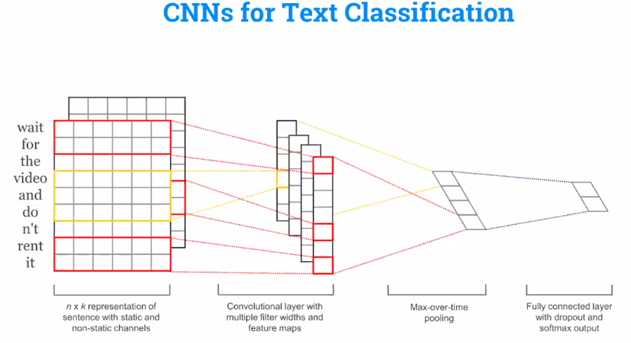

Slide 43
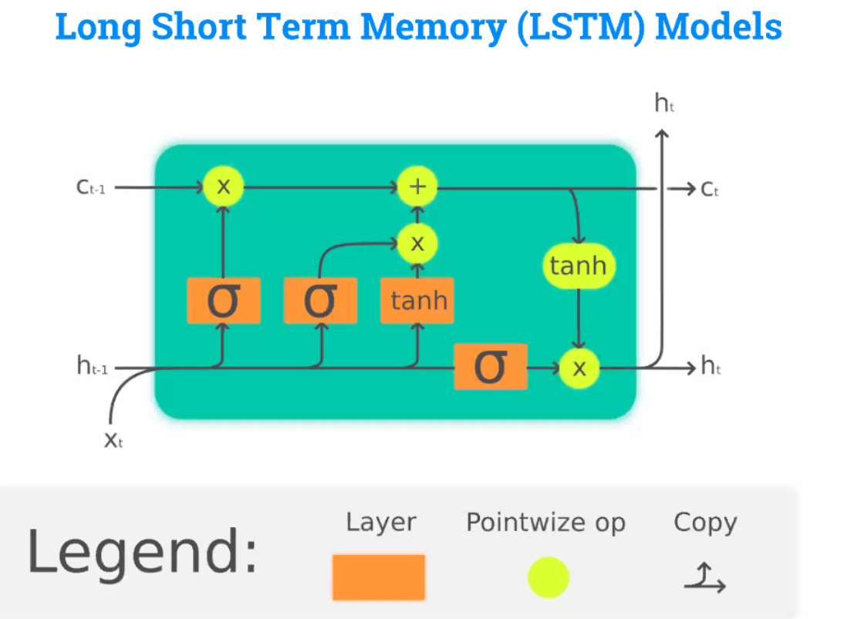

Slide 44
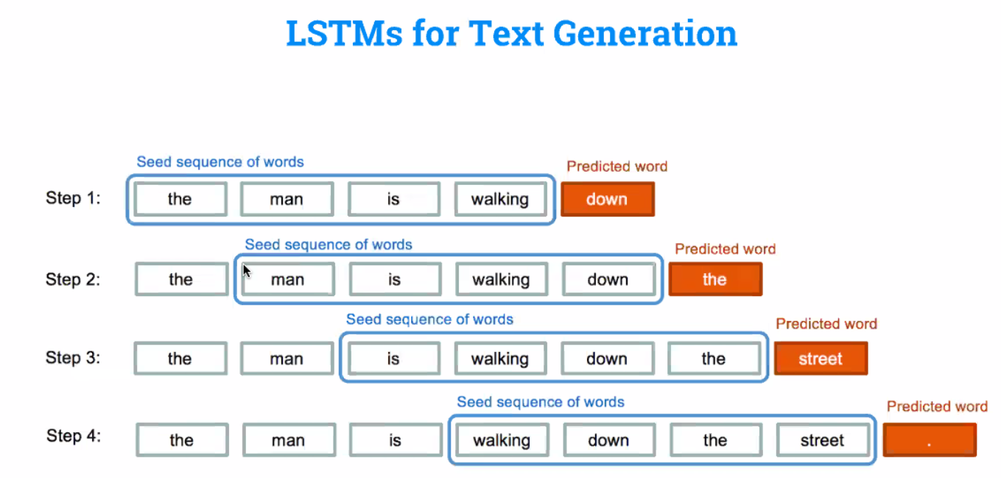

Slide 45
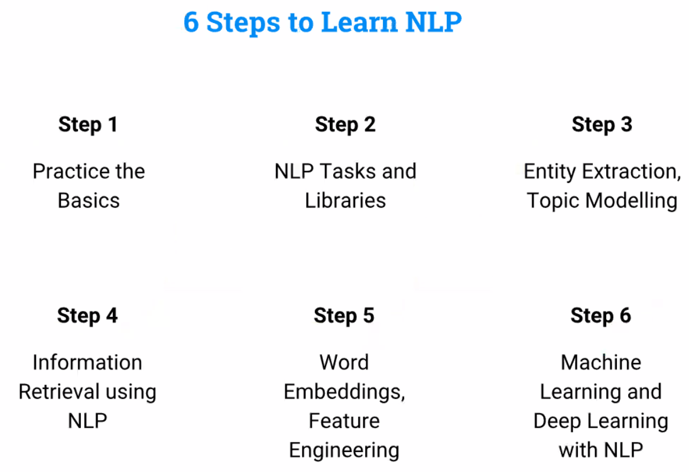

Slide 46
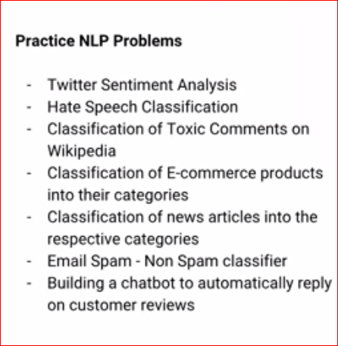

Slide 47
MINING CUSTOMER REVIEWS
We focused on the following questions for analysing the reviews:
What are the keywords and topics of discussion across the comments?
What elements of the restaurant would they want improved – service, staff behaviour, ambience etc.?
What is the overall mood of the customers visiting the restaurant?
Using advanced techniques of text analytics - machine learning for topics classification, sentiment analysis, and more, we developed a module where restaurant collected reviews could also be analysed and compared for taking better decisions.
Challenge
Offering critical insights into brand perception and competitive scenarios to experience brands wanting to manage and learn from data on review sites that is viewed by millions.
Solution
We scrapped over 10 million customer reviews for more than 100000 restaurants across India.

Slide 48
Handson

